Slide 1


Phishing Attacks Overview
Phishing attacks are deceptive strategies employed by cybercriminals to manipulate individuals into revealing sensitive information such as passwords and credit card numbers. This presentation aims to provide valuable insights on identifying phishing attempts, recognizing the social engineering techniques often used by attackers, and implementing effective protective measures to safeguard personal and organizational information.

Slide 2

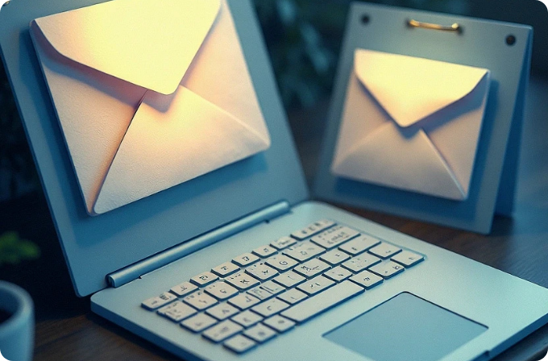
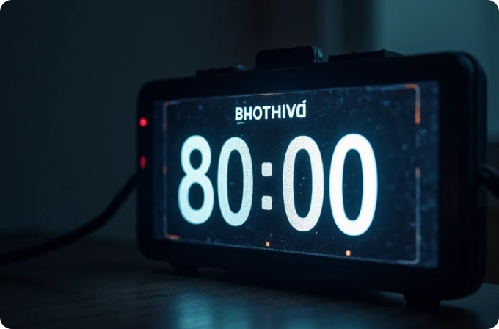
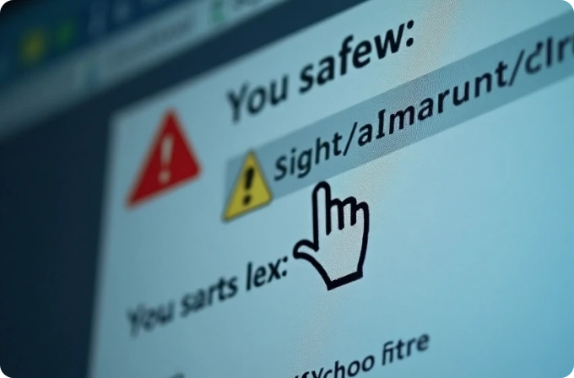
Recognizing Phishing Emails
Unusual Sender Addresses
Generic Greetings
Always check the sender’s email address for inconsistencies or misspellings. Cybercriminals often mimic legitimate addresses to gain trust.
Be wary of emails that use generic greetings like 'Dear Customer' instead of your name. Real companies address you by name to personalize communication.
Urgent Calls to Action
Suspicious Links and Attachments
Phishing emails often create a sense of urgency, urging immediate action. Legitimate companies typically provide ample time for responses.
Hover over links to see their actual destination. Avoid clicking on unexpected attachments, as they may contain malware.

Slide 3




Recognizing Fake Websites
URL Inspection
Inconsistent Branding
Always verify the website's URL for authenticity, paying close attention to the domain name.
1
2
Fake websites often have mismatched logos, colors, or design elements.
Request for Excessive Information
Typos and Grammatical Errors
4
3
Many fraudulent sites have poor spelling and grammar, which can be a strong indicator of deceit.
Be cautious of sites asking for unnecessary personal data.

Slide 4








Understanding Social Engineering Tactics
1
2
Pretexting
Phishing via Phone Calls
Attackers create a false narrative to manipulate the victim into sharing confidential information.
Known as 'vishing', attackers may call and pose as bank representatives to elicit sensitive information.
3
4
Fear and Intimidation
Impersonation Techniques
Attackers may use threats, claiming your account will be locked unless you provide information.
Cybercriminals often impersonate trusted brands or individuals to gain trust.

Slide 5
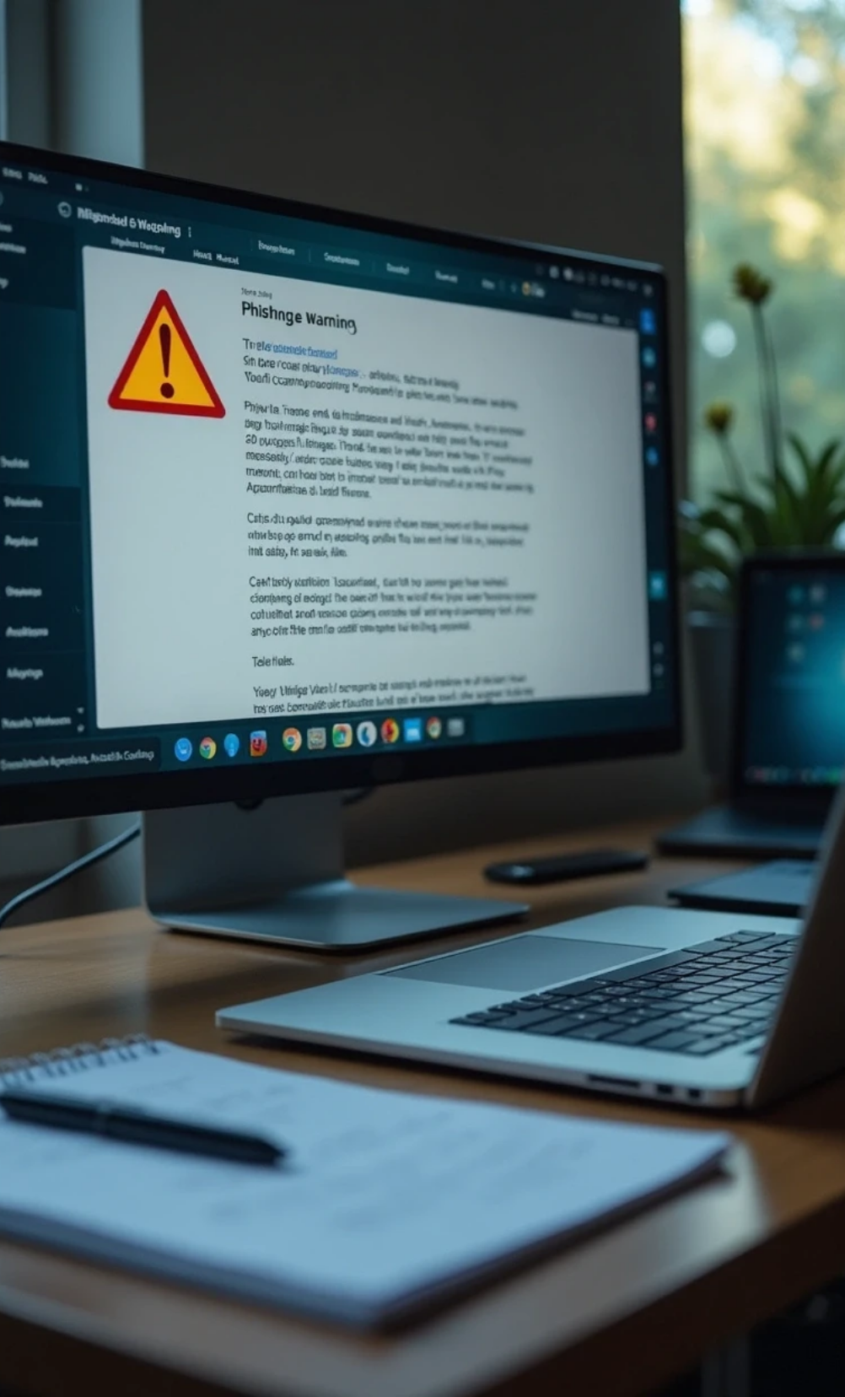









Best Practices to Avoid Phishing
1
2
Verify Directly
Educate Yourself and Others
Contact the sender using verified methods, not from the suspicious message.
Keep updated on the latest phishing techniques for better awareness.
3
4
Use Two-Factor Authentication
Install Security Software
Utilize updated antivirus software for ongoing protection.
Add security by requiring extra verification steps.

Slide 6




Real-World Examples of Phishing
Target Data Breach
Google and Facebook Scam
A phishing attack in 2013 led to a massive data breach for Target, affecting millions of customers.
1
2
A Lithuanian hacker tricked Google and Facebook into transferring over $100 million by sending fake invoices.
Health Insurance Phishing
Office 365 Impersonation
During COVID-19, criminals exploited fears with health insurance phishing campaigns.
4
3
Cybercriminals impersonated Microsoft Office 365 to steal logins through fake login pages.

Slide 7
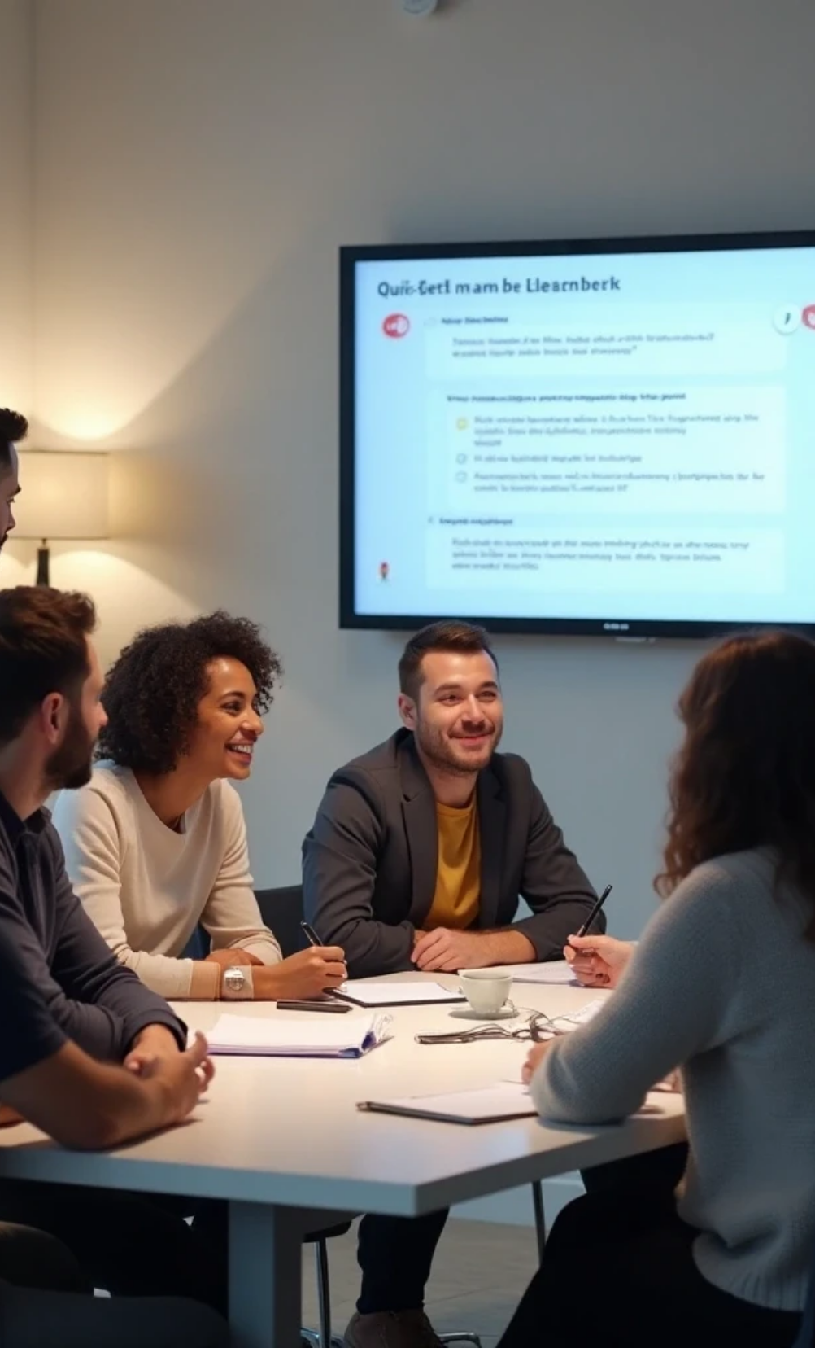
Phishing Awareness Quiz
Title
Choose the answer you think is correct by clicking the option.
Each option links to instant feedback (Correct / Incorrect).
Try to score as many as you can — tips appear after each question.
Buttons to create: “Start Quiz”

Slide 8

Q1 — Email sender check
Question text: You receive an email that appears to be from your bank saying “We detected unusual activity — click here to verify your account.” The email address reads support@bank.co (notice .co instead of .com). What do you do?
Options:
A) Click the link and enter my login so the bank can verify.
B) Reply asking for more details and attach a screenshot.
C) Do not click; go to the bank’s website by typing the URL or call the bank using the number on the back of your card. ✓ (Correct)
D) Forward to a friend to ask if it’s real.
Correct: C
Explanation shown on correct-feedback: Domain looks wrong — .co vs .com. Always access financial accounts through bookmarked/typed URLs or official app/phone number.
Q2 — Urgent payment request
Question: Your manager sends a short email: “I need you to purchase 10 gift cards and send the codes ASAP. Don’t tell anyone.” The sender’s display name is correct but the email address is mngr@contoso-org.com (not the usual @contoso.com). What’s the best action?
Options:
A) Buy the cards and send codes right away to be helpful.
B) Call your manager using the internal directory or walk to their desk to confirm. ✓ (Correct)
C) Forward the request to finance without asking.
D) Ignore the message.
Correct: B
Explanation: Urgent and secretive gift-card requests are classic business email compromise (BEC). Verify through a separate channel.
Q3 — Link preview
Question: Hovering over a link in an email shows this URL: http://tinyurl.com/9aBCd?secure-bank.com. What does that tell you?
Options:
A) It's definitely safe because it contains “secure-bank.com”.
B) The link could redirect — inspect full target before clicking or avoid it entirely. ✓ (Correct)
C) It’s safe if the email looks professional.
D) If it’s tinyurl it’s always safe.
Correct: B
Explanation: Shorteners can redirect to malicious sites. Inspect the final domain (use preview/unshorten) or go directly to the institution’s site.
Q4 — Attachment type
Question: You receive an email from HR with an attachment named Payroll_Update.exe. What’s the right action?
Options:
A) Open it — it’s from HR so it should be fine.
B) Scan it with your antivirus and then open it.
C) Do not open .exe attachments — contact HR to confirm and ask for a safer format (PDF). ✓ (Correct)
D) Save it to desktop and open later.
Correct: C
Explanation: Executables are rarely sent legitimately. Ask to resend as PDF or confirm via another channel.
Q5 — Spot the phishing elements (image-based / spot-the-phish)
Slide: Show a screenshot (or mocked email) with multiple red flags (misspelling in greeting, bad logo, mismatched “from” address, urgent language, a shortened link).
Question: Which three of the following are red flags in this email?
Options (multi-select style presented as buttons that each link to feedback — encourage selecting three):
A) Greeting: “Dear Valued Customer” instead of name ✓
B) Official logo used properly
C) Misspelled bank name ✓
D) Link text looks legitimate but hover reveals a different domain ✓
Correct: A, C, D
Explanation: Generic greetings, spelling/branding errors, and mismatched link targets are common phishing indicators.
Q6 — Too good to be true
Question: You’re notified on a social platform you won a $1,000 gift card and need to click to claim. The message asks for your email and phone. What to do?
Options:
A) Enter details to claim prize.
B) Ignore and delete the message — it’s likely a scam. ✓ (Correct)
C) Share the post on your timeline to claim faster.
D) Reply with “Is this real?”
Correct: B
Explanation: Unexpected prizes asking for personal contact info are typically scams.
Q7 — SSL padlock misunderstanding
Question: A website shows a padlock next to the URL. That means:
Options:
A) The site is safe and legitimate.
B) The connection is encrypted, but you still must verify the site’s identity. ✓ (Correct)
C) It’s a government site.
D) It always means no phishing risk.
Correct: B
Explanation: Padlock = encrypted connection only; attackers can still host phishing pages with HTTPS.
Q8 — Phone / Vishing
Question: Someone calls claiming to be IT support, asks for your password to “fix” an issue. You should:
Options:
A) Give the password so IT can help.
B) Offer to let them remote in.
C) Politely refuse and report the call to IT; real IT never asks for your password. ✓ (Correct)
D) Tell them your password but change it later.
Correct: C
Explanation: Support shouldn't ask for credentials. Use verified internal channels.
Q9 — Password reuse
Question: Which practice reduces account takeover risk the most?
Options:
A) Use the same strong password everywhere.
B) Use simple passwords but update weekly.
C) Use a unique password per account + enable multi-factor authentication (MFA). ✓ (Correct)
D) Only use social logins.
Correct: C
Explanation: Unique passwords + MFA protects accounts even if one site is breached.
Q10 — Phishing URL subtlety
Question: Which URL is most likely malicious?
A) https://paypal.com.secure-login.info/verify ✓
B) https://paypal.com/secure/verify (on the official domain)
C) https://paypal.com (exact)

Slide 9



Conclusion
Phishing attacks pose significant risks, but by recognizing the signs and understanding social engineering tactics, we can protect ourselves and our organizations. Continuous education is vital to stay ahead of evolving threats, and fostering a culture of security awareness empowers everyone to act against phishing attempts.
Recap of Key Points
Encouragement to Stay Informed
Call to Action
Phishing attacks are common but can be avoided with vigilance.
Encourage the audience to share their knowledge with others.
Cyber threats evolve rapidly, making ongoing education essential.

